Slide 1
BMD ENG 301 Quantitative Systems Physiology (Nervous System)
Lecture 8: Action Potential (Ion Channels)
2022_v1
Professor Malcolm MacIver

Slide 2
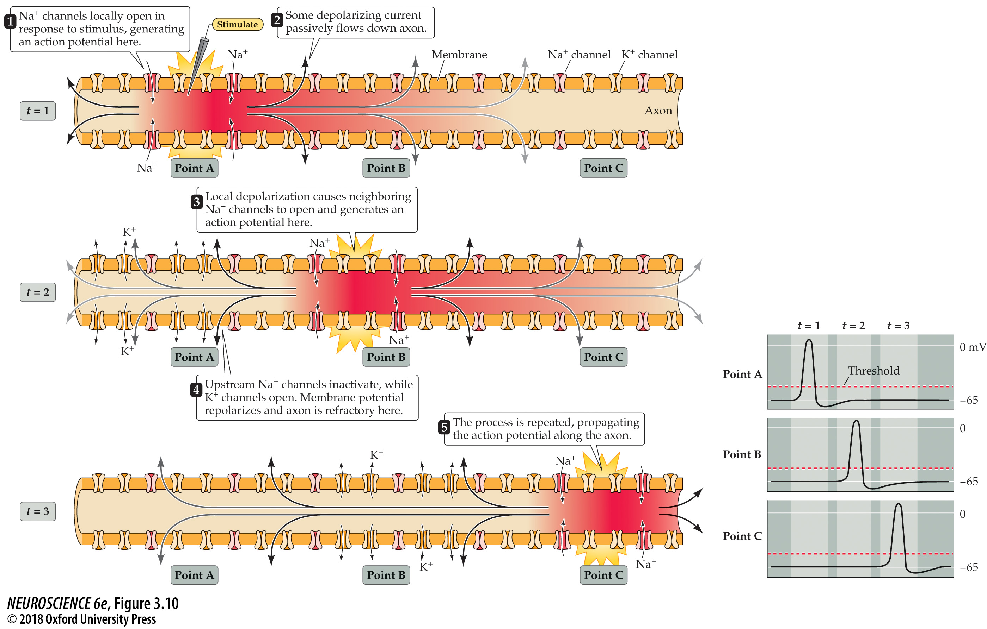
Action potential conduction requires both active and passive current flow
Notes:
FIGURE 3.10 Action potential conduction requires both active and passive current flow. Depolarization opens Na⁺ channels locally and produces an action potential at point A of the axon (time t = 1). The resulting inward current flows passively along the axon, depolarizing the adjacent region (point B) of the axon. At a later time (t = 2), the depolarization of the adjacent membrane has opened Na⁺ channels at point B, resulting in the initiation of the action potential at this site and additional inward current that again spreads passively to an adjacent point (point C) farther along the axon. At a still later time (t = 3), the action potential has propagated even farther. This cycle continues along the full length of the axon. Note that as the action potential spreads, the membrane potential repolarizes due to K⁺ channel opening and Na⁺ channel inactivation, leaving a “wake” of refractoriness behind the action potential that prevents its backward propagation. The lower panel shows the time course of membrane potential changes at the points indicated.

Slide 3
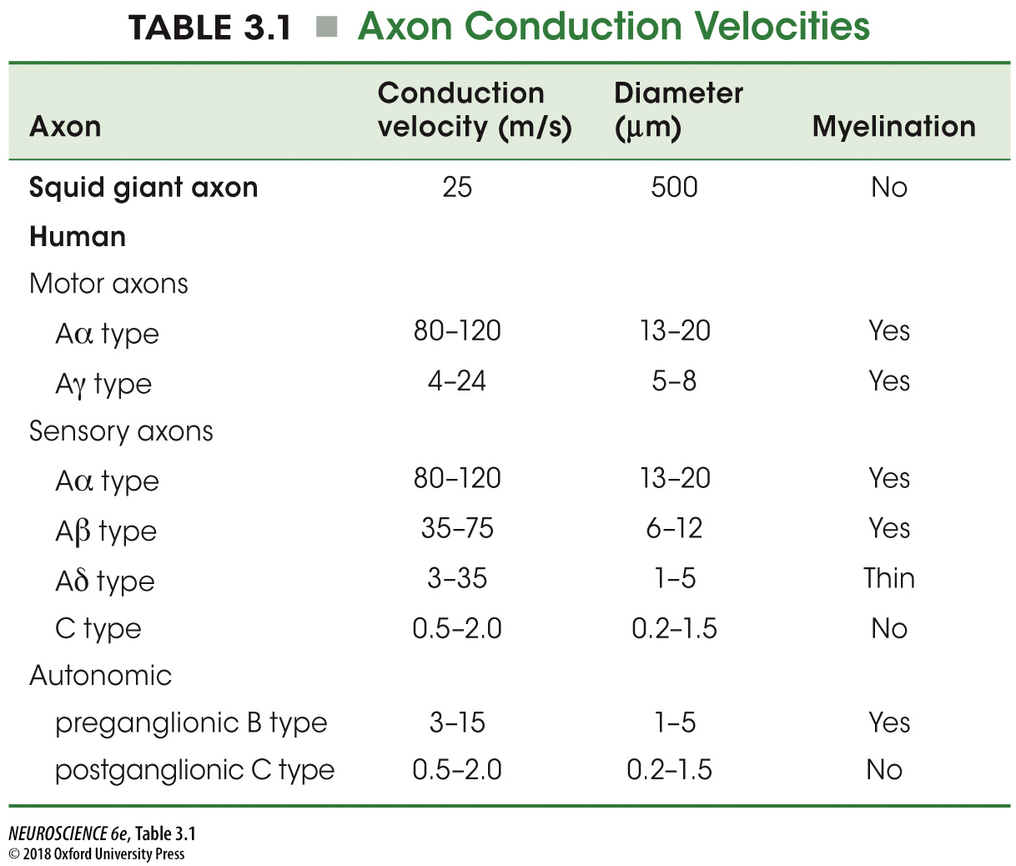
Notes:
TABLE 3.1 Axon Conduction Velocities

Slide 4
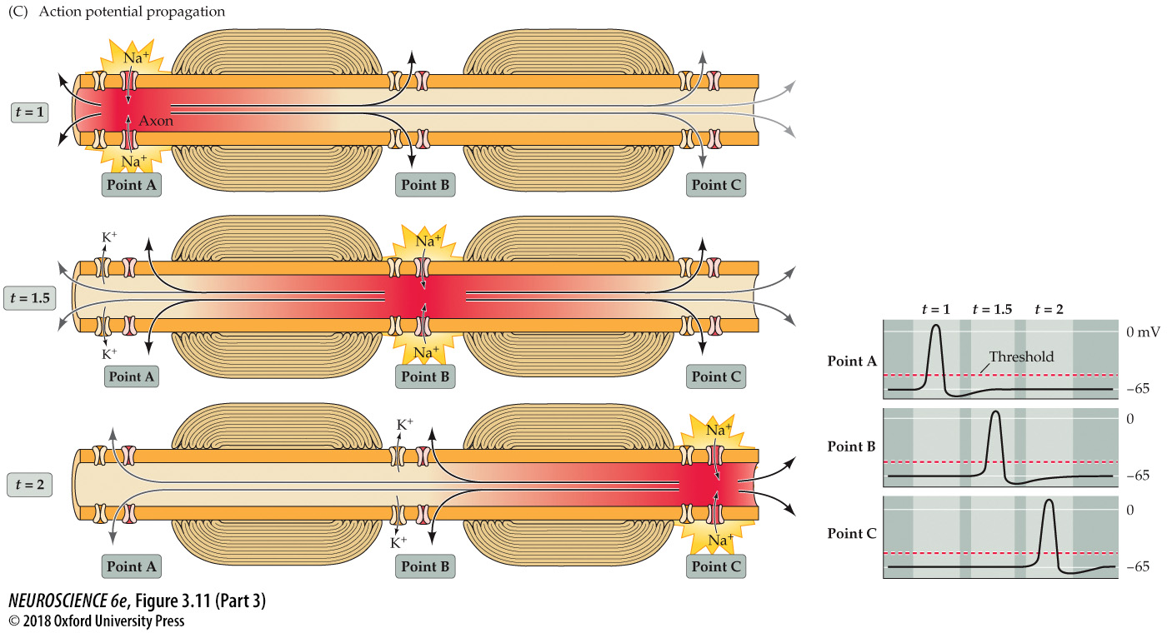
Saltatory action potential conduction
Notes:
FIGURE 3.11 Saltatory action potential conduction along a myelinated axon. (A) Diagram of a myelinated axon. (B) Localization of voltage-gated Na⁺ channels (red) at a node of Ranvier in a myelinated axon of the optic nerve. Green indicates the protein Caspr, which is located adjacent to the node of Ranvier. (C) Local current in response to action potential initiation at a particular site flows locally, as described in Figure 3.10. However, the presence of myelin prevents the local current from leaking across the internodal membrane; it therefore flows farther along the axon than it would in the absence of myelin, reaching several adjacent nodes (for clarity, only one node is shown). Moreover, voltage-gated Na⁺ channels are present only at the nodes of Ranvier (voltage-gated K⁺ channels are present at the nodes of some axons, but not others). This arrangement means that the generation of active, voltage-gated Na⁺ currents need occur only at these unmyelinated regions. Bottom panel: The more rapid conduction of action potentials is illustrated by the more rapid timing of action potentials at the points indicated.

Slide 5
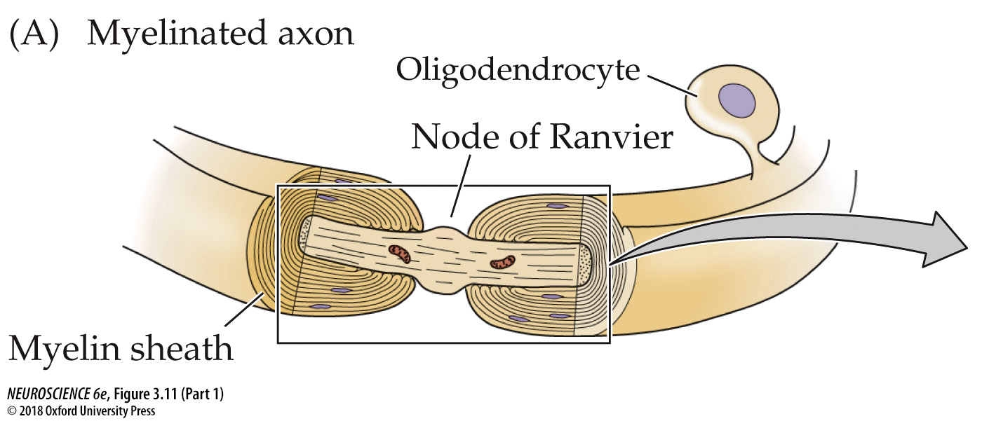
Saltatory action potential conduction
Notes:
FIGURE 3.11 Saltatory action potential conduction along a myelinated axon. (A) Diagram of a myelinated axon. (B) Localization of voltage-gated Na⁺ channels (red) at a node of Ranvier in a myelinated axon of the optic nerve. Green indicates the protein Caspr, which is located adjacent to the node of Ranvier. (C) Local current in response to action potential initiation at a particular site flows locally, as described in Figure 3.10. However, the presence of myelin prevents the local current from leaking across the internodal membrane; it therefore flows farther along the axon than it would in the absence of myelin, reaching several adjacent nodes (for clarity, only one node is shown). Moreover, voltage-gated Na⁺ channels are present only at the nodes of Ranvier (voltage-gated K⁺ channels are present at the nodes of some axons, but not others). This arrangement means that the generation of active, voltage-gated Na⁺ currents need occur only at these unmyelinated regions. Bottom panel: The more rapid conduction of action potentials is illustrated by the more rapid timing of action potentials at the points indicated.

Slide 6
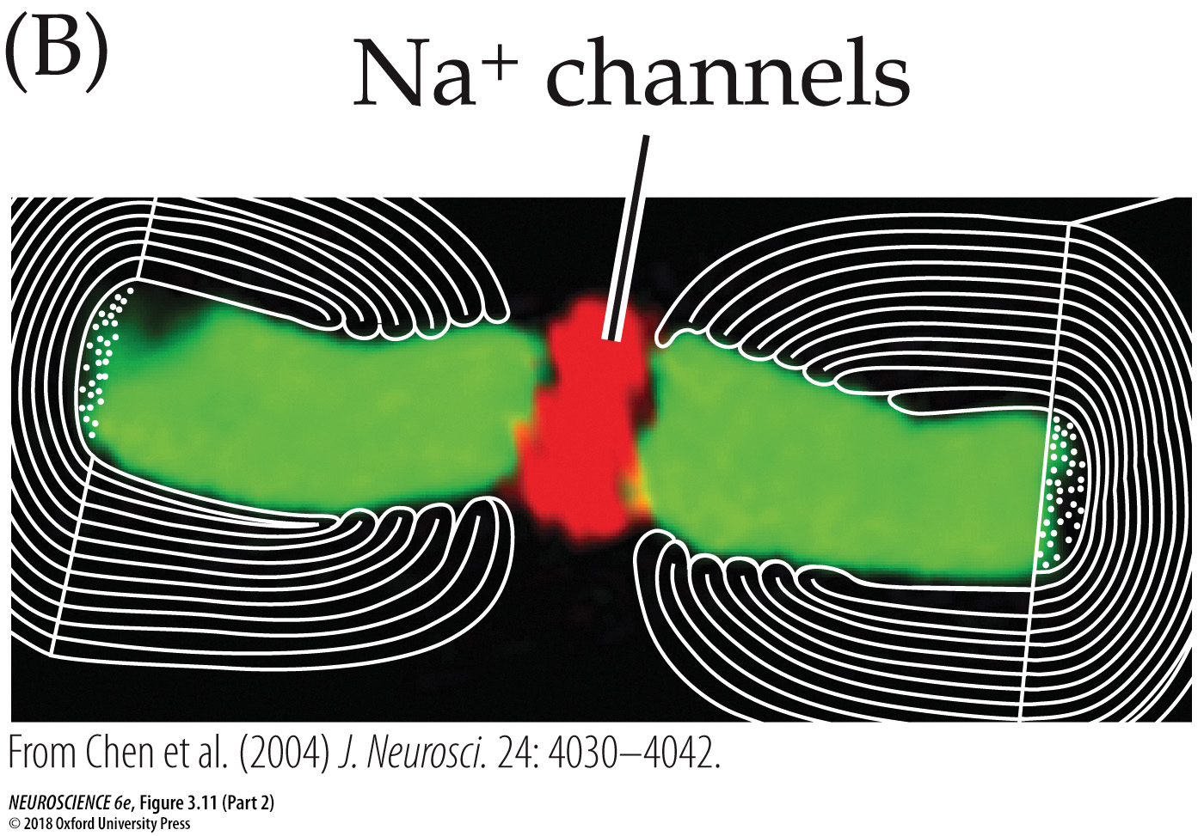
Notes:
FIGURE 3.11 Saltatory action potential conduction along a myelinated axon. (A) Diagram of a myelinated axon. (B) Localization of voltage-gated Na⁺ channels (red) at a node of Ranvier in a myelinated axon of the optic nerve. Green indicates the protein Caspr, which is located adjacent to the node of Ranvier. (C) Local current in response to action potential initiation at a particular site flows locally, as described in Figure 3.10. However, the presence of myelin prevents the local current from leaking across the internodal membrane; it therefore flows farther along the axon than it would in the absence of myelin, reaching several adjacent nodes (for clarity, only one node is shown). Moreover, voltage-gated Na⁺ channels are present only at the nodes of Ranvier (voltage-gated K⁺ channels are present at the nodes of some axons, but not others). This arrangement means that the generation of active, voltage-gated Na⁺ currents need occur only at these unmyelinated regions. Bottom panel: The more rapid conduction of action potentials is illustrated by the more rapid timing of action potentials at the points indicated. (B from Chen et al., 2004, J. Neurosci. 24: 4030–4042.)

Slide 7
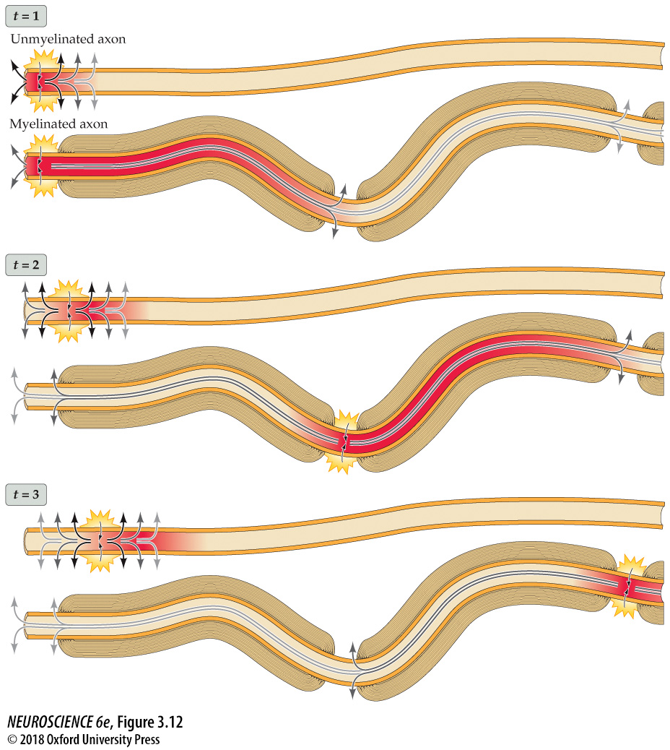
Myelin increases conduction speed
Notes:
FIGURE 3.12 Myelin increases action potential conduction speed. The diagram compares the speed of action potential conduction in unmyelinated (upper panel in each pair) and myelinated (lower panels) axons. Passive conduction of current is shown by arrows.

Slide 8
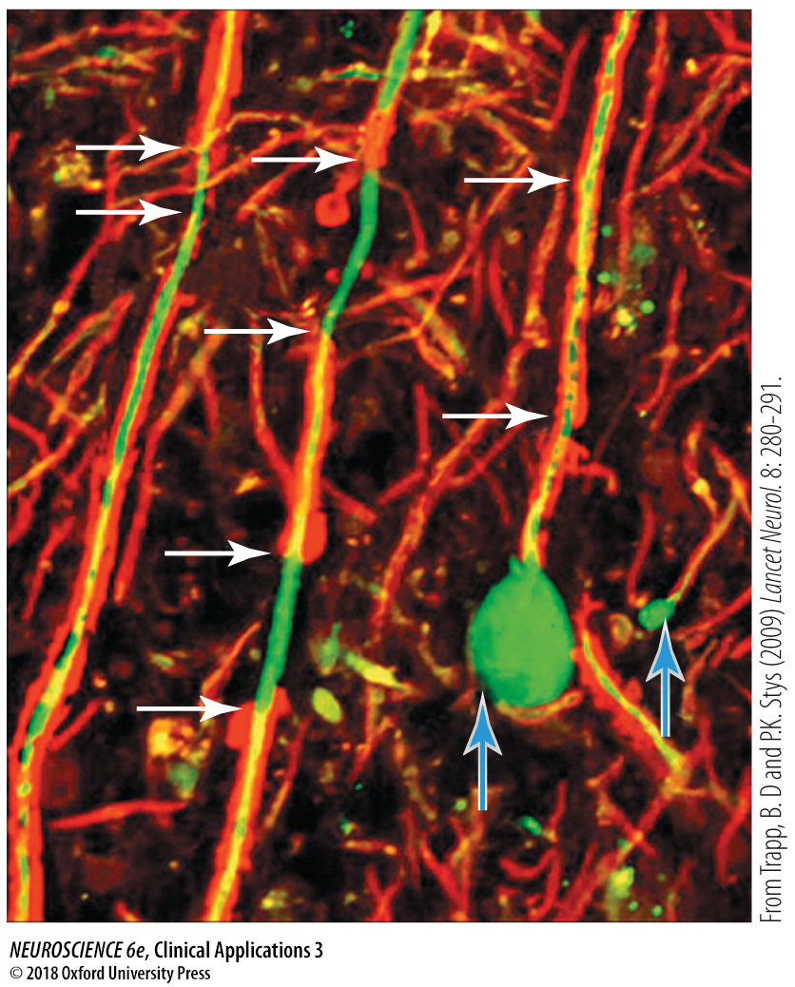
Notes:
CLINICAL APPLICATIONS Multiple Sclerosis
Demyelination of axons in multiple sclerosis. Myelin (red) ordinarily surrounds axons (green). In MS, axons lose myelin (horizontal arrows) and can break as a result (vertical arrows). (From Trapp and Stys (2009) Lancet Neurol. 8: 280−291.)

Slide 9
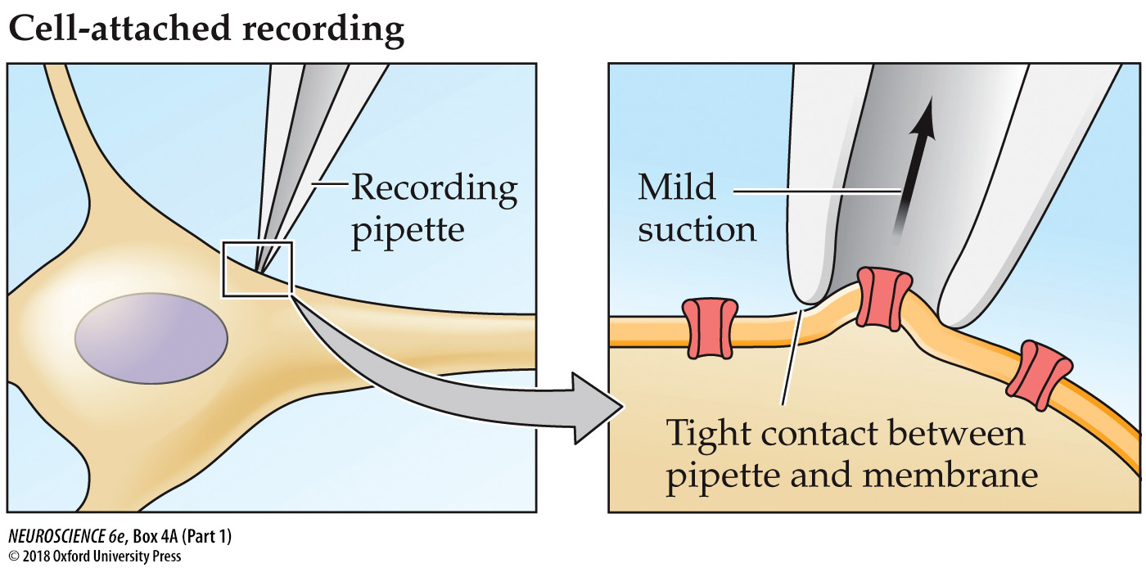
The Patch Clamp Method
Notes:
BOX 4A The Patch Clamp Method
Four configurations in patch clamp measurements of ion currents.

Slide 10
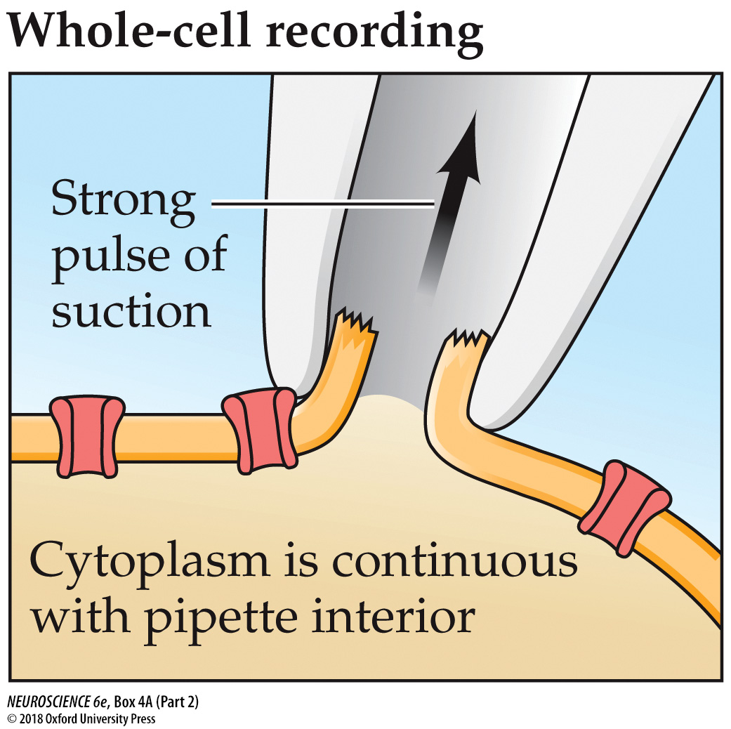
The Patch Clamp Method
Notes:
BOX 4A The Patch Clamp Method
Four configurations in patch clamp measurements of ion currents.

Slide 11
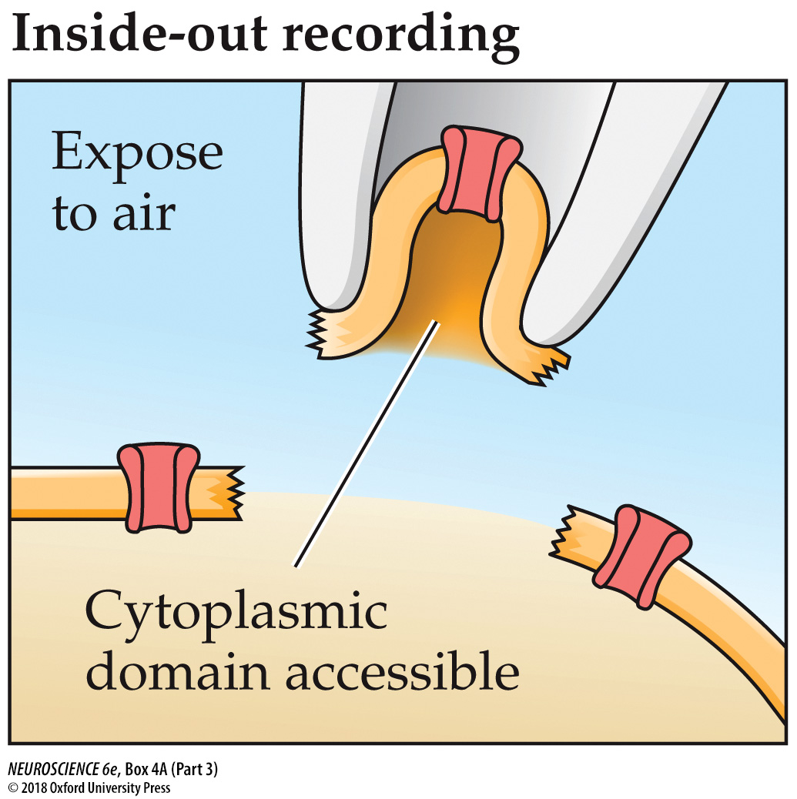
The Patch Clamp Method
Notes:
BOX 4A The Patch Clamp Method
Four configurations in patch clamp measurements of ion currents.

Slide 12
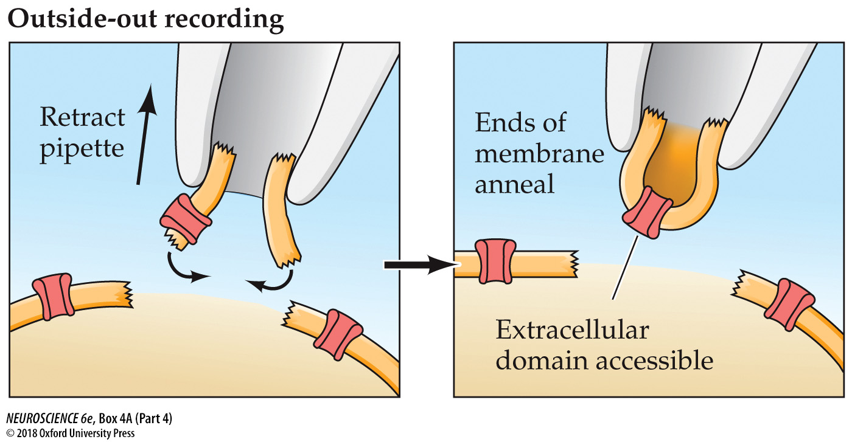
The Patch Clamp Method
Notes:
BOX 4A The Patch Clamp Method
Four configurations in patch clamp measurements of ion currents.

Slide 13
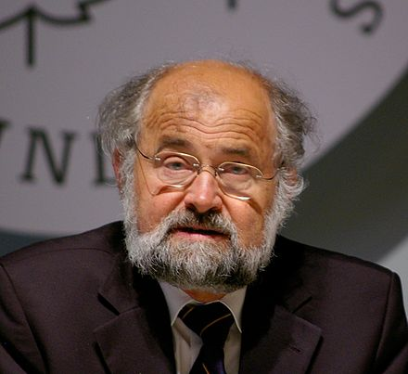
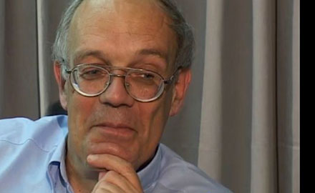
Patch Clamp Technique
Erwin Neher and
Bert Sakmann
Nobel Prize for Physiology or Medicine, 1991

Slide 14
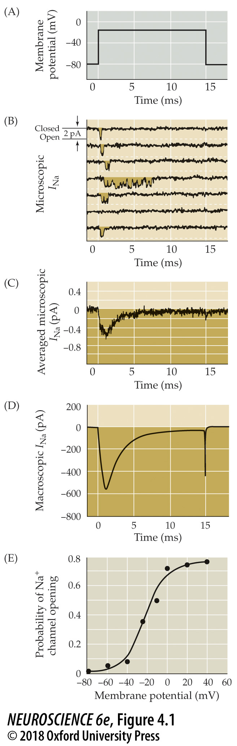
Patch clamp measurements of ion currents flowing through single Na⁺ channels in a squid giant axon
Notes:
FIGURE 4.1 Patch clamp measurements of ion currents flowing through single Na⁺ channels in a squid giant axon. In these experiments, Cs⁺ was applied to the axon to block voltage-gated K⁺ channels. Depolarizing voltage pulses (A) applied to a patch of membrane containing a single Na⁺ channel result in brief currents (B, downward deflections) in the seven successive recordings of membrane current (I_{Na}). (C) The average of many such current records shows that most channels open in the initial 1–2 ms following depolarization of the membrane, after which the probability of channel openings diminishes because of channel inactivation. (D) A macroscopic current measured from another axon shows the close correlation between the time courses of microscopic and macroscopic Na⁺ currents. (E) The probability of a Na⁺ channel opening depends on the membrane potential, increasing as the membrane is depolarized. (B,C after Bezanilla and Correa, 1995; D after Vandenburg and Bezanilla, 1991; E after Correa and Bezanilla, 1994.)

Slide 15
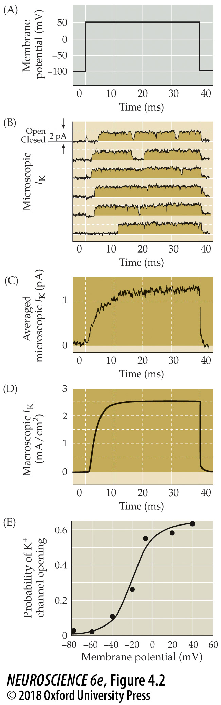
Patch clamp measurements of ion currents flowing through single K+ channels in a squid giant axon
Notes:
FIGURE 4.2 Patch clamp measurements of ion currents flowing through single K⁺ channels in a squid giant axon. In these experiments, tetrodotoxin was applied to the axon to block voltage-gated Na⁺ channels. Depolarizing voltage pulses (A) applied to a patch of membrane containing a single K⁺ channel result in brief currents (B, upward deflections) whenever the channel opens. (C) The average of such current records shows that most channels open with a delay, but remain open for the duration of the depolarization. (D) A macroscopic current measured from another axon shows the correlation between the time courses of microscopic and macroscopic K⁺ currents. (E) Membrane potential controls K⁺ channel opening, with the probability of a channel opening increasing as the membrane is depolarized. (B–D after Augustine and Bezanilla, 1990; E after Perozo et al., 1991.)

Slide 16
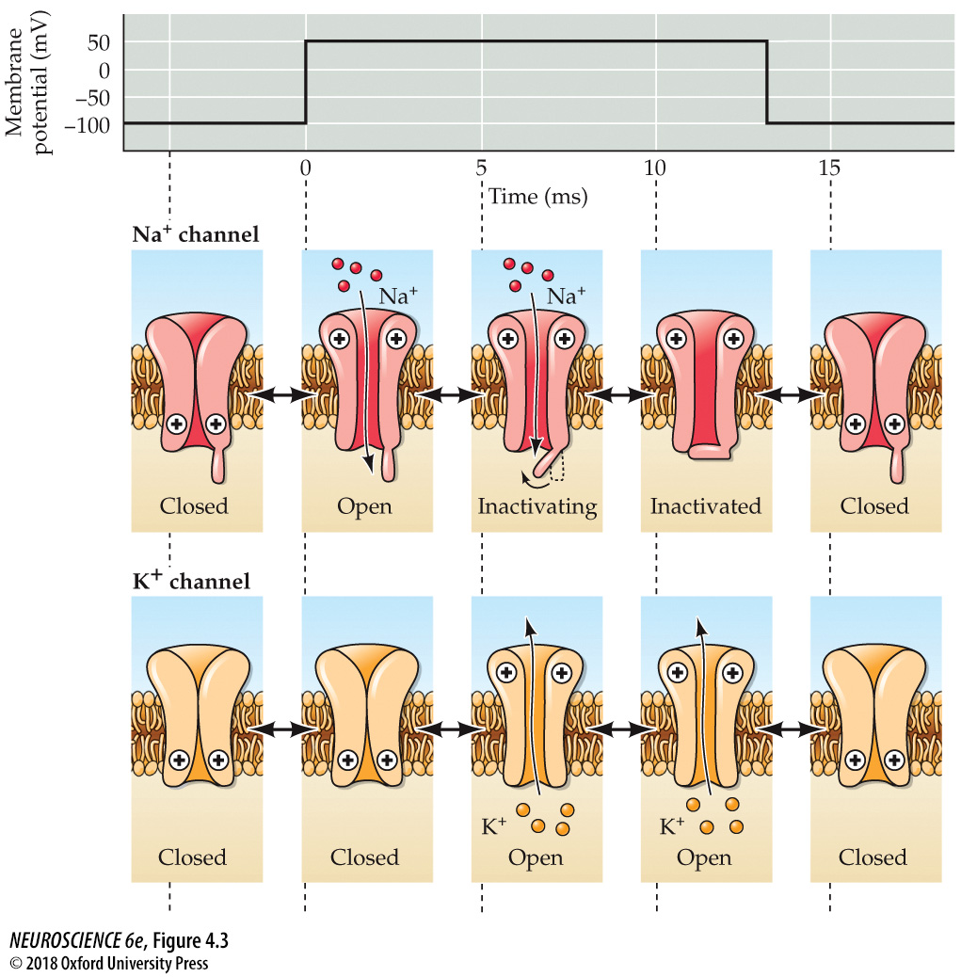
Functional states of voltage-gated Na⁺ and K⁺ channels
Notes:
FIGURE 4.3 Functional states of voltage-gated Na⁺ and K⁺ channels. The gates of both channels are closed when the membrane potential is hyperpolarized. When the potential is depolarized, voltage sensors (indicated by +) allow the channel gates to open—first the Na⁺ channels and then the K⁺ channels. Na⁺ channels also inactivate during prolonged depolarization, whereas many types of K⁺ channels do not.

Slide 17
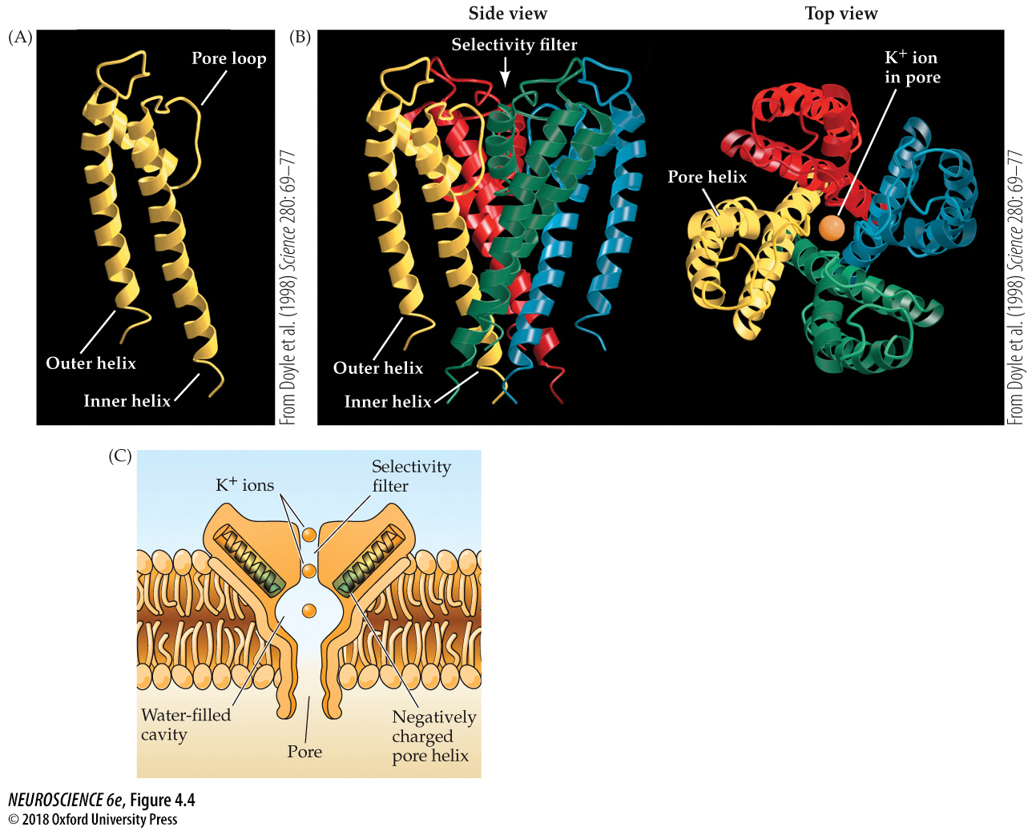

Structure of a simple bacterial K⁺ channel determined by crystallography
Roderick MacKinnon
Nobel Prize in Chemistry 2003
Notes:
FIGURE 4.4 Structure of a simple bacterial K⁺ channel determined by crystallography. (A) Structure of one subunit of the channel, which consists of two membrane-spanning domains and a pore loop that inserts into the membrane. (B) Three-dimensional arrangement of four subunits (each in a different color) to form a K⁺ channel. The right-hand view is from the top of the channel, showing a K⁺ ion (yellow) within the channel pore. (C) The permeation pathway of the K⁺ channel consists of a large aqueous cavity connected to a narrow selectivity filter. Helical domains of the channel point negative charges (green) toward this cavity, allowing K⁺ ions (yellow) to become dehydrated and then move through the selectivity filter. (A, B from Doyle et al., 1998.)

Slide 18
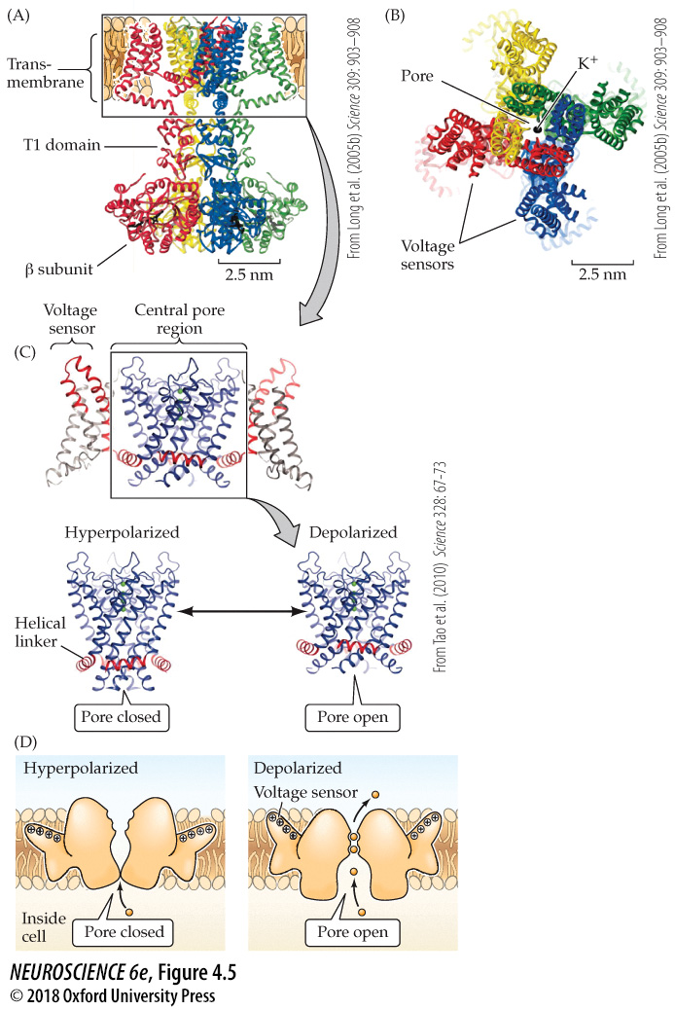
Structure of a mammalian voltage-gated K⁺ channel
Notes:
FIGURE 4.5 Structure of a mammalian voltage-gated K⁺ channel. (A) The channel includes four subunits (in different colors), each possessing a transmembrane domain and a T1 domain. Attached to each T1 domain is a β subunit. (B) When viewed from above, the transmembrane domain can be seen to have separate domains for voltage sensing and for forming the K⁺-conducting pore (K⁺ indicated by black spheres in the middle of the pore). (C) Model for voltage-dependent gating of the K⁺ channel. Upper: structure of the central pore domain of the voltage-gated K⁺ channel in the open (depolarized) state. Lower: Depolarization pushes the voltage sensor toward the extracellular surface of the membrane, pulling on the linker (red) and thereby opening the channel pore (blue). Conversely, hyperpolarization pulls the sensor down, pushing down on this linker and shutting the channel pore. (D) Model for movement of the voltage sensor. Depolarization causes the paddle-like voltage sensor domain to move toward the extracellular surface of the membrane, while hyperpolarization causes it to move toward the intracellular surface. (A, B from Long et al., 2005; C from Tao et al., 2010; D after Lee, 2006.)

Slide 19
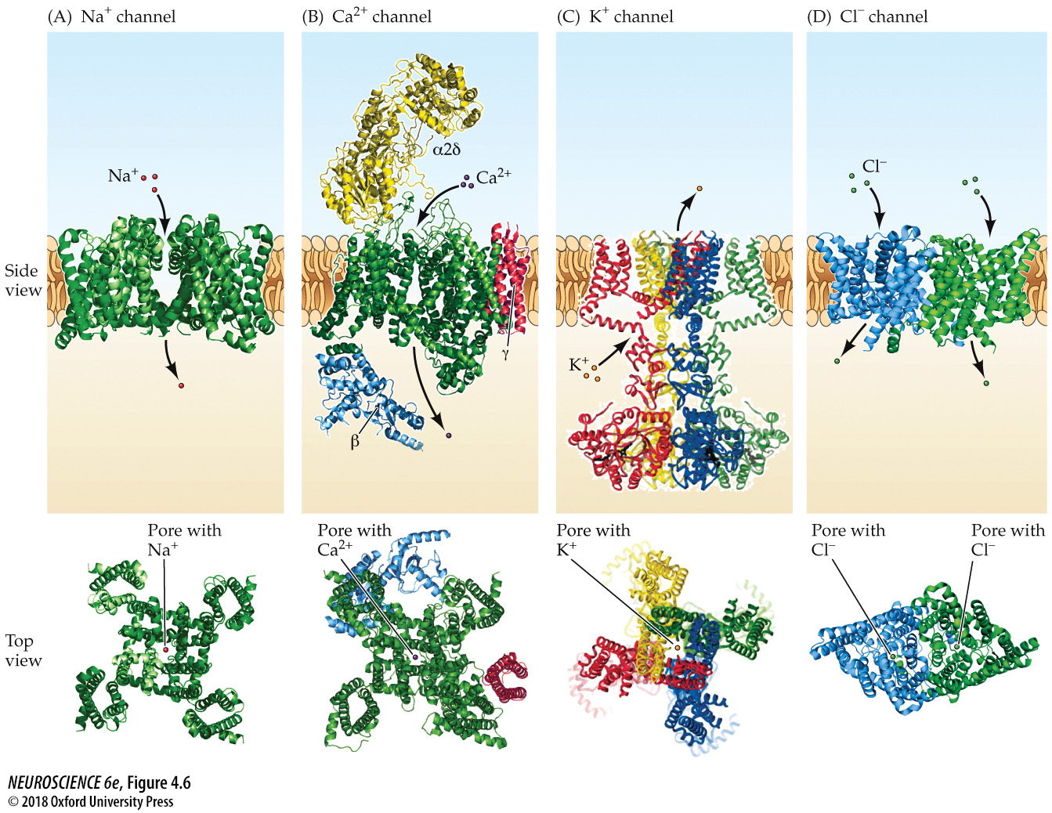
Types of voltage-gated ion channels
Notes:
FIGURE 4.6 Types of voltage-gated ion channels. Examples of voltage-gated channels include those selectively permeable to Na⁺ (A), Ca²⁺ (B), K⁺ (C), and Cl– (D). All channels include a number of transmembrane domains that form pores; the selectivity filters of these pores determine ion selectivity, while other structures are responsible for sensing the membrane potential and for gating pore opening and closing. Side view shows the channels within the plasma membrane; top view shows the transmembrane structures of the channels, emphasizing similarities between the Na⁺, Ca²⁺, and K⁺ channels. γ, α2δ, and β indicate accessory subunits of the Ca²⁺ channel. (A after Ahuja et al., 2015; B after Wu et al., 2015; C from Long et al., 2005; D after Dutzler et al., 2002.)

Slide 20
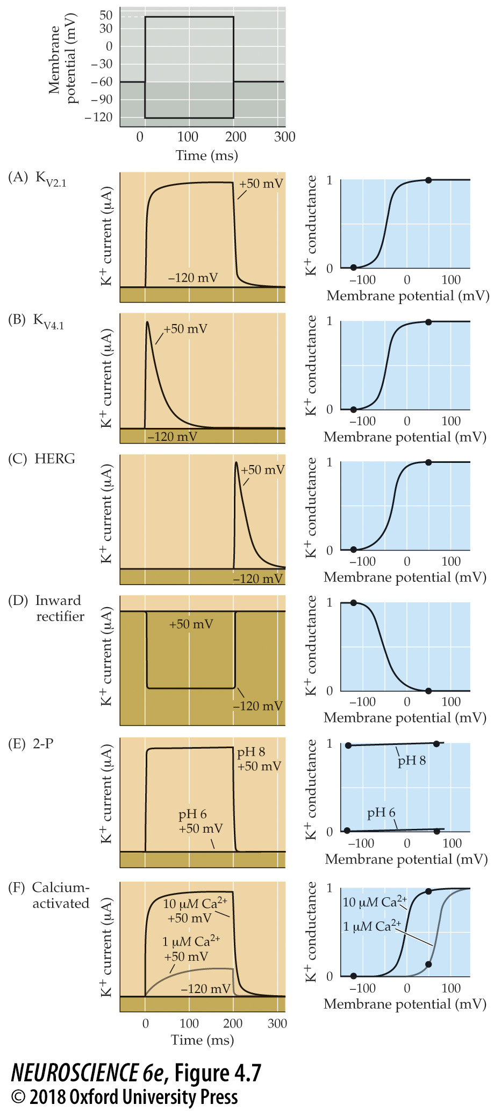
Diverse properties of K⁺ channels
Notes:
FIGURE 4.7 Diverse properties of K⁺ channels. Different types of K⁺ channels were expressed in Xenopus oocytes, and the voltage clamp method was used to change the membrane potential (top) and measure the resulting currents flowing through each type of channel. These K⁺ channels vary markedly in their gating properties, as evident in their currents (left) and conductances (right). (A) K_{V2.1} channels show little inactivation and are closely related to the delayed rectifier K⁺ channels involved in action potential repolarization. (B) K_{V4.1} channels inactivate during a depolarization and help regulate the interval between action potentials during repetitive firing. (C) HERG channels (KCNH2 gene) inactivate so rapidly that current flows only when inactivation is rapidly removed at the end of a depolarization. (D) Inward rectifying K⁺ channels allow more K⁺ current to flow at hyperpolarized potentials than at depolarized potentials. (E) 2-P K⁺ channels usually respond to chemical signals rather than to changes in membrane potential. In the case of the TASK channel (KCNK9 gene) shown here, changes in extracellular pH regulate channel opening while membrane potential changes do not. (F) Ca²⁺-activated K⁺ channels open in response to intracellular Ca²⁺ ions and, in some cases, membrane depolarization.

Slide 21
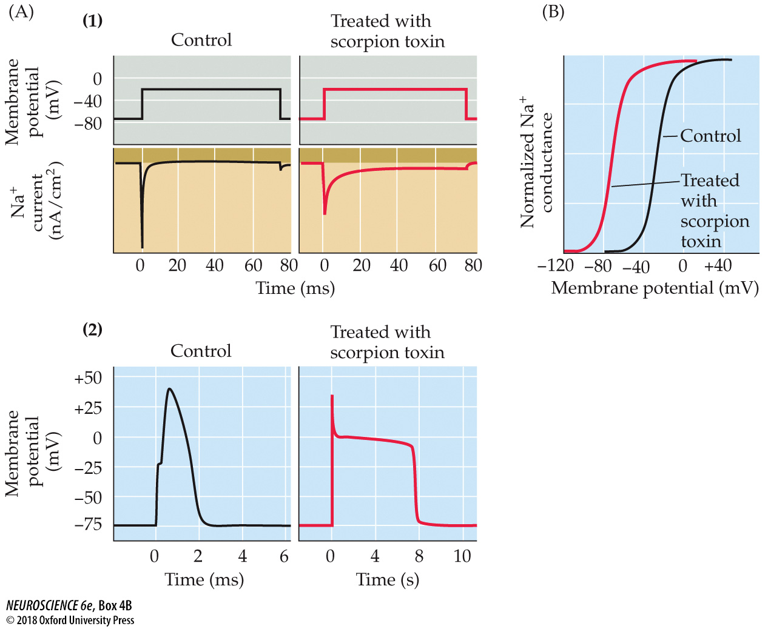
Toxins That Poison Ion Channels
Notes:
BOX 4B Toxins That Poison Ion Channels
(A) Effects of toxin treatment on Na⁺ channels of frog axons. (1) α-Toxin from the scorpion Leiurus quinquestriatus prolongs Na⁺ currents recorded with the voltage clamp method. (2) As a result of the increased Na⁺ current, α-toxin greatly prolongs the duration of the axonal action potential. Note the change in timescale after treating with toxin. (B) Treatment with β-toxin from another scorpion, Centruroides sculpturatus, shifts the activation of Na⁺ channels, so that Na⁺ conductance begins to increase at potentials much more negative than usual. (A after Schmidt and Schmidt, 1972; B after Cahalan, 1975.)

Slide 22
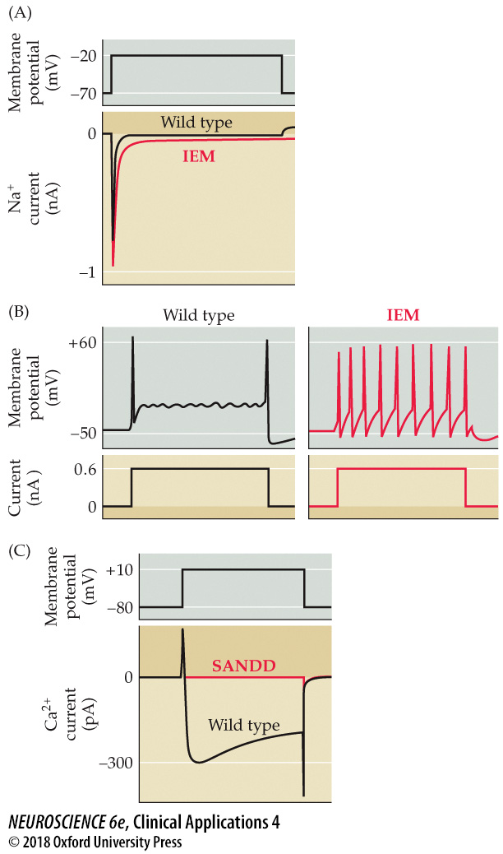
CLINICAL APPLICATIONS Neurological Diseases Caused by Altered Ion Channels
Notes:
CLINICAL APPLICATIONS Neurological Diseases Caused by Altered Ion Channels
(A) Enhancement in voltage-gated Na⁺ current caused by IEM-associated mutation in the SCN9A gene. Wild type refers to the normal, unmutated form of channel. (B) Increased action potential firing caused by IEM-associated mutation in the SCN9A gene. (C) Loss of voltage-gated Ca²⁺ current caused by SANDD-associated mutation in the CACNA1D gene. (A, B after Waxman and Zamponi, 2014; C after Baig et al., 2011.)

Slide 23
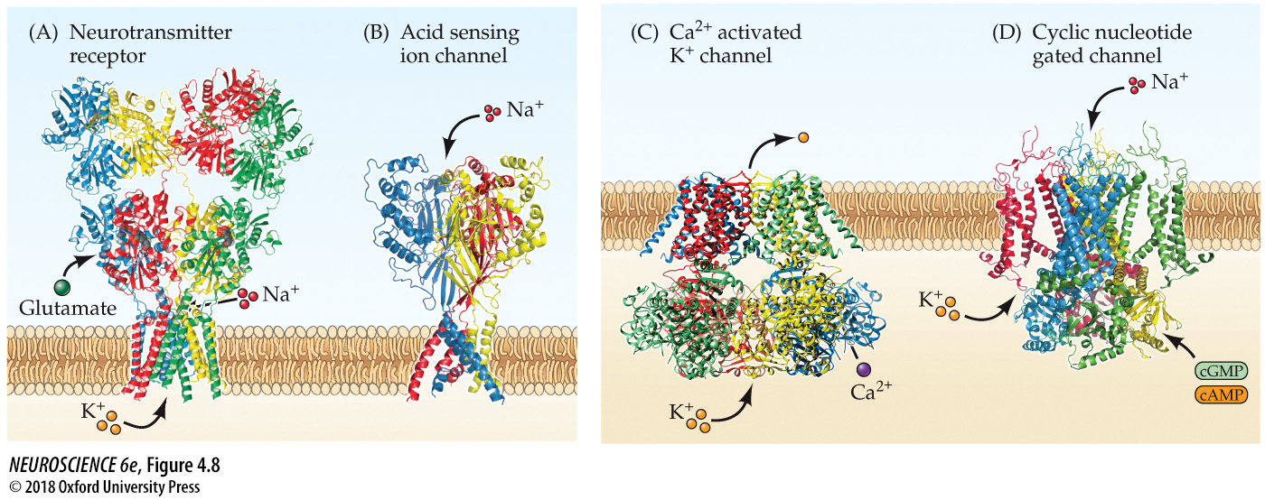
Ligand-gated ion channels
Notes:
FIGURE 4.8 Ligand-gated ion channels. Some ligand-gated ion channels are activated by the extracellular presence of neurotransmitters, such as glutamate (A), while others are activated by extracellular H⁺ (B). Still other channels are activated by intracellular second messengers, such as Ca²⁺ (C) or the cyclic nucleotides cAMP and cGMP (D). (A from Sobolevsky et al., 2009; B from Gonzalez et al., 2009; C from Hite et al., 2017; D from Li et al., 2017.)

Slide 24
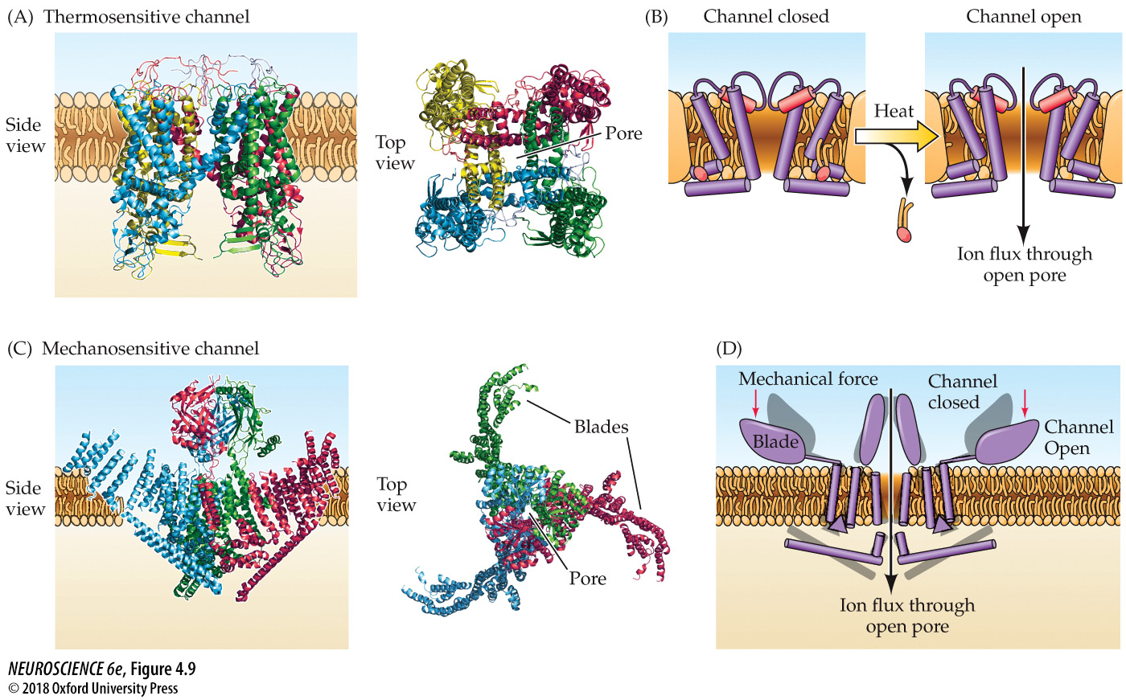
Thermosensitive and mechanosensitive channels
Notes:
FIGURE 4.9 Thermosensitive and mechanosensitive channels. (A) The TRPV1 channel responds to heat as well as to chemical signals such as capsaicin. This channel consists of four subunits, which form a central cation-selective pore. (B)Heat is thought to open the TRPV1 channel pore by displacing membrane lipids closely associated with the channel, leading to a structural rearrangement that opens channel gates (red). (C) Piezo, an example of a mechanosensitive channel, has a unique structure that includes three subunits and large blades on the extracellular side of the channel. (D) The Piezo channel pore is thought to open when mechanical force displaces the blades, leading to rearrangement of the structure of the rest of the channel. (A after Gao et al., 2016; B after Ge et al., 2015.)

Slide 25
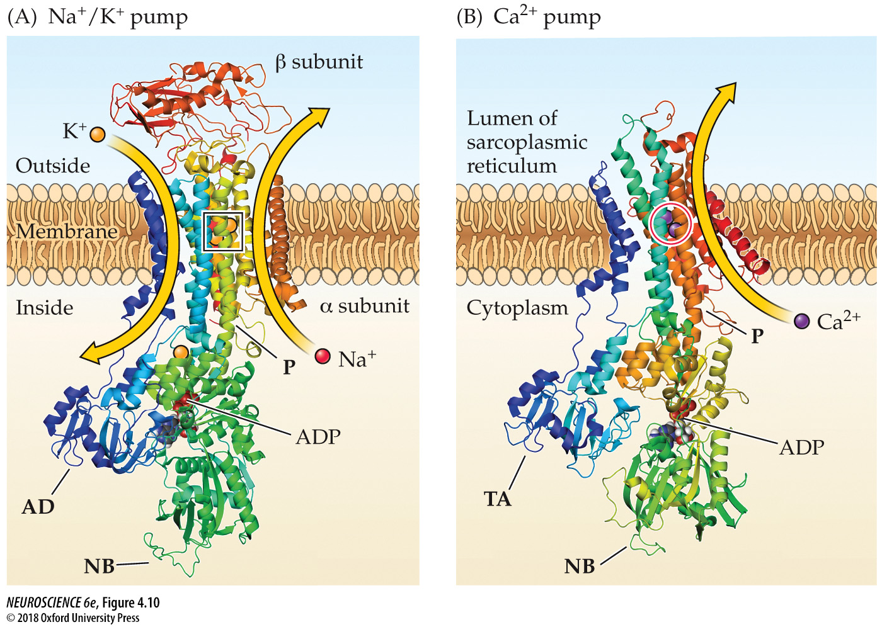
Examples of ATPase pumps
Notes:
FIGURE 4.10 Examples of ATPase pumps. (A) Structure of the Na⁺ pump. Domains responsible for nucleotide binding (NB), phosphorylation (P), and an actuator domain (AD) are evident. In this conformation, ADP occupies the NB domain of the pump, and two K⁺ (inside square) can be observed in the transmembrane domain. Activity of the pump leads to transfer of Na⁺ from inside to outside, and of K⁺ in the opposite direction. (B) Structure of the SERCA Ca²⁺ pump. Domains responsible for nucleotide binding (NB), phosphorylation (P), and ion translocation activity (TA) are indicated. Shown is the structure of the pump when bound to ADP; in this state, two Ca²⁺ (purple spheres within red circle) are sequestered within the membrane-spanning regions of the pump. Note the similarity between this structure and that of the Na⁺/K⁺ pump shown in (A). (A after Shinoda et al., 2009; B after Toyoshima et al., 2004.)

Slide 26
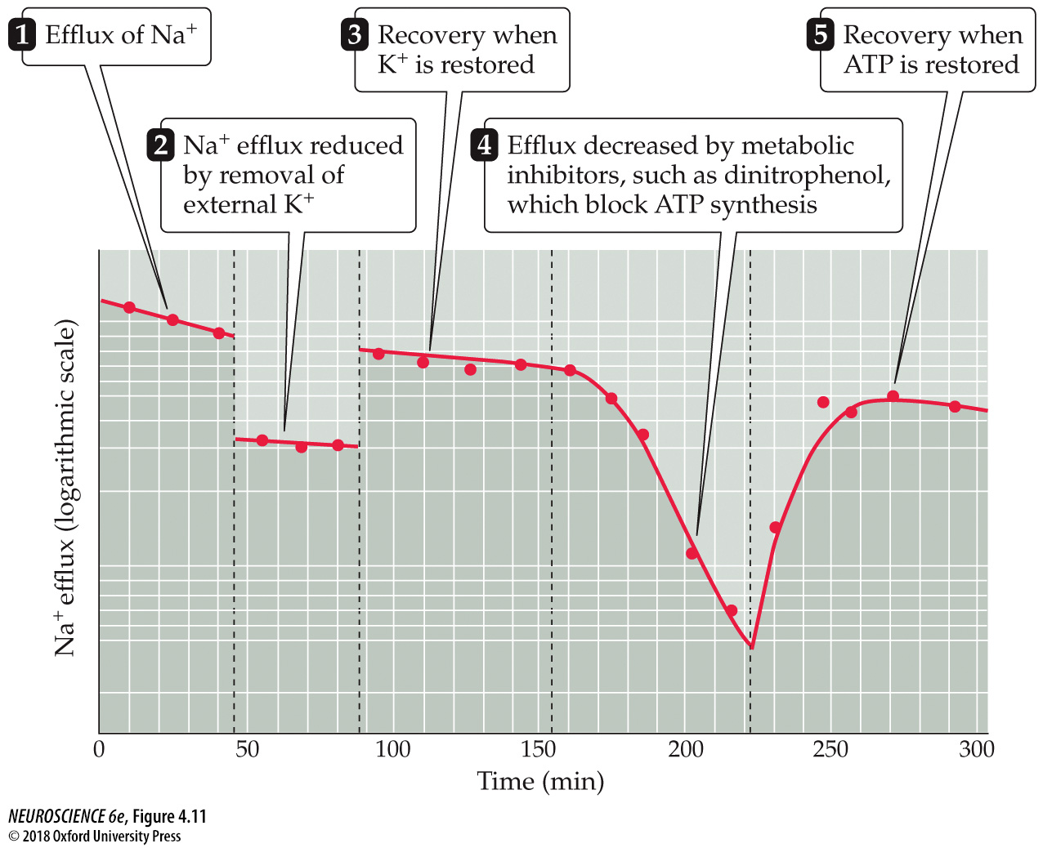
Ion movements due to the Na⁺ pump
Notes:
FIGURE 4.11 Ion movements due to the Na⁺ pump. Measurement of radioactive Na⁺ efflux from a squid giant axon. This efflux depends on external K⁺ and intracellular ATP. (After Hodgkin and Keynes, 1955.)

Slide 27
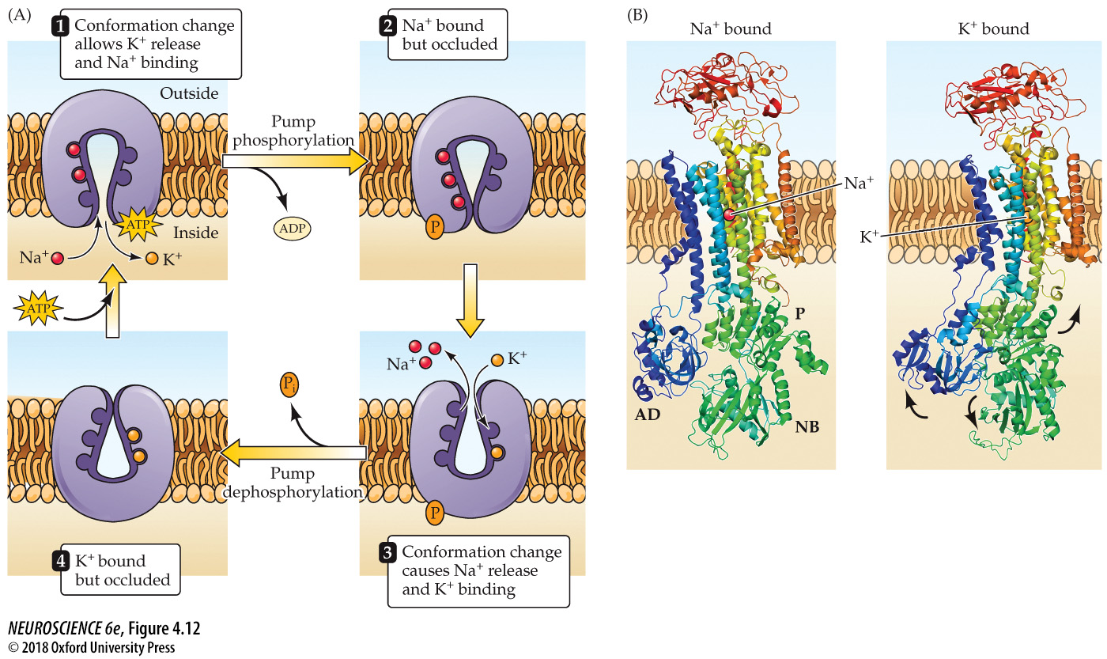
Translocation of Na⁺ and K⁺ by the Na⁺ pump
Notes:
FIGURE 4.12 Translocation of Na⁺ and K⁺ by the Na⁺ pump. (A) A model for the movement of ions by the Na⁺ pump. Uphill movements of Na⁺ and K⁺ are driven by binding and hydrolysis of ATP, which phosphorylates the pump (indicated by P). These ion fluxes are asymmetrical, with 3 Na⁺ carried out for every 2 K⁺ brought in. (B) Comparison of structure of the Na⁺ pump in Na⁺-bound state (left), corresponding to step 2 in (A), and K⁺-bound (right) state, corresponding to step 4. Changes in location of phosphorylation (P), nucleotide binding (NB), and activator (AD) domains (arrows) are associated with switch between Na⁺-bound and K⁺-bound conformations. (A after Lingrel et al., 1994; B after Nyblom et al., 2013.)

Slide 28
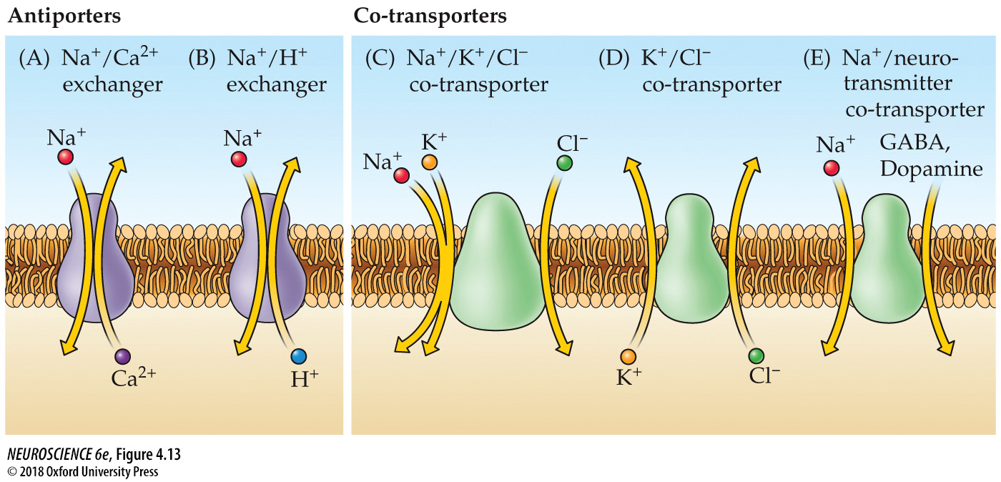
Examples of ion exchangers
Notes:
FIGURE 4.13 Examples of ion exchangers. Ion exchangers use the electrochemical gradients of co-transported ions as a source of energy. These exchangers can be further subdivided into antiporters that swap ions on the two sides of the membrane (A,B) and co-transporters that carry multiple ions in the same direction (C–E).

